Slide 1
Introduction to Biostatistics
June 17, 2019 10:30-11:45, KAM 21/23 Sandy Eckel, PhD
eckel@usc.edu
Associate Professor USC Division of Biostatistics
Notes:
https://faculty.franklin.uga.edu/dhall/sites/faculty.franklin.uga.edu.dhall/files/lec1.pdf

Slide 2
Welcome: 3 summer programs!
Bridging the Gaps [USC Keck School of Medicine] 8 weeks: clinical and basic science, health disparities, physiology, biostatistics https://keck.usc.edu/bridging-the-gaps-program/
SPIDOR [USC Physiology & Neuroscience, Preventive Medicine] Summer Program in Diabetes and Obesity Research 10 weeks: basic science, translational, clinical research https://preventivemedicine.usc.edu/education/summer-programs/summer-program-in-diabetes-and-obesity-research-spidor/
LA's Best [USC Preventive Medicine] LA’s Biostatistics Education Summer Training program at USC 6 weeks: biostatistics, health data science https://pm.usc.edu/lasbest

Slide 3
Today: introduction to biostatistics
Introduce myself/my research Case study: career in academic biostatistics
Define biostatistics
Outline biostatistical thinking
Signal vs. noise
Types of data
Population vs. sample
Measures of central tendency/spread
Convince you that:
Biostatistics is important
Biostatistics is fun
You can create/interpret biostatistical results!

Slide 4

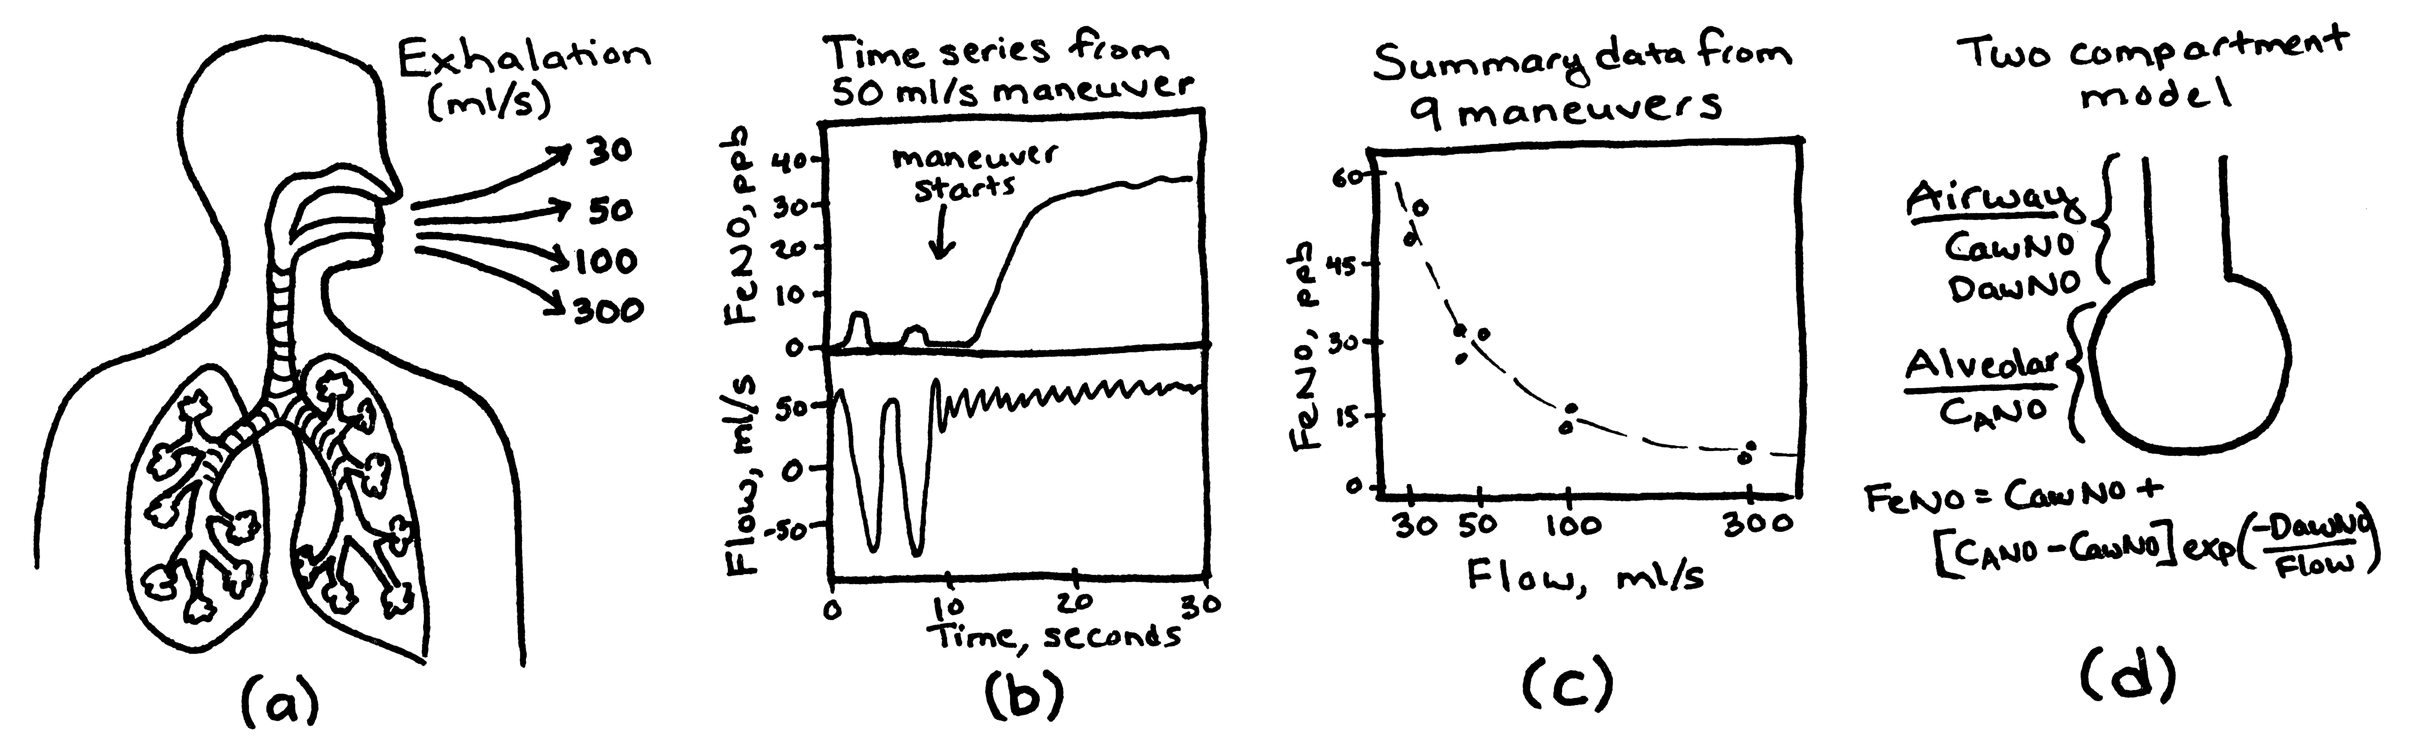
Who am I?
Associate Professor of Biostatistics
Department of Preventive Medicine
Keck School of Medicine of USC
What do I do?
Teaching (~18%)
Research (~75%) – NIH funded research program
PI: Statistical methods for exhaled breath biomarker
mPI: PRISMS Data and Software Coordinating Center Statistical approaches for wearable sensor data in studies of pediatric asthma
co-I: 6+ other collaborative projects
Sandy Eckel, PhD eckel@usc.edu
http://www-hsc.usc.edu/~eckel/

Slide 5

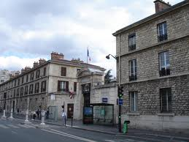
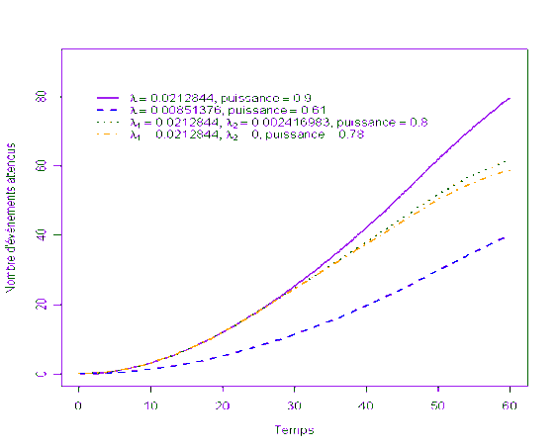


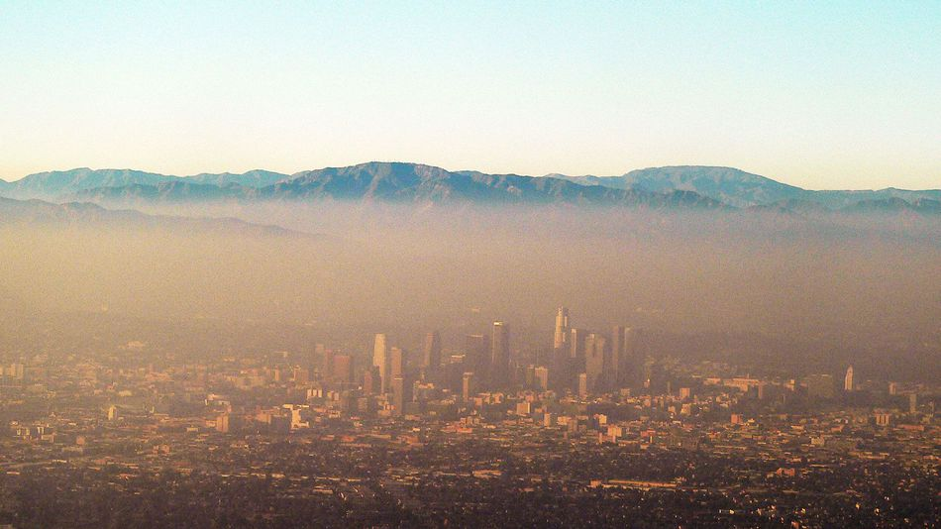
How did I become a biostatistician at USC?
In college – studied math and french
Junior year in Paris
Biostatistics internship
Took all available statistics courses senior year
Directly entered a biostatistics PhD Program
Thesis: Statistical methods for studying air pollution health effects in older adults
Joined USC to pursue interest in air pollution health effects
Children’s Health Study

Slide 6
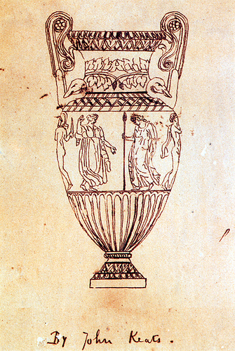
What is Biostatistics?
Merriam Webster’s Dictionary: statistics applied to the analysis of biological data
Statistics:
Mathematical body of science dealing with the collection, analysis, interpretation, and presentation of (biological) data
NOT just calculating “statistics” (e.g., mean, median, mode)
A philosophy of biostatistics:
“Search for the truth”
– Scott Zeger (my first biostatistics instructor)
“Beauty is truth, truth beauty”
– Ode on a Grecian Urn, Johns Keats
Many specialized branches of biostatistics e.g., statistical genetics, environmental statistics, clinical trials, etc.
Notes:
Transitive property: truth = beauty

Slide 7
Why is biostatistics important?
Provides a method to summarize and characterize data
Helps us decide whether our observations deviate from expectation or random chance (accept/reject null hypothesis)
Helps quantify the magnitude by which our data deviate from expectation (estimate, p-value, confidence interval)
Provides a way to compare results across studies
Provides tools to design a study to answer a scientific question
How many subjects we will need for a given study?

Slide 8

Biostatistics in 2019
January 2009, Hal Varian, Google’s Chief Economist: “…the sexy job in the next 10 years will be statisticians”
https://www.mckinsey.com/industries/high-tech/our-insights/hal-varian-on-how-the-web-challenges-managers
and important skills are to be able to take data and:
Understand it
Process it
Extract value from it
Visualize it
Communicate it
http://drewconway.com/zia/2013/3/26/the-data-science-venn-diagram

Slide 9
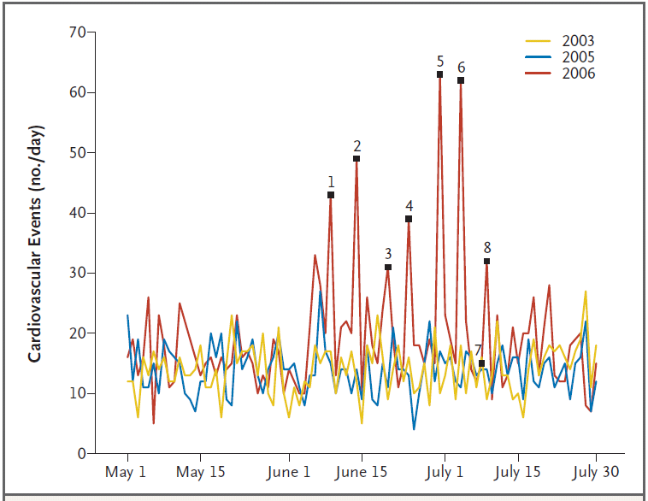
How can we start to think statistically?
Some associations are immediately apparent
Daily Cardiovascular Events
The 2006 World Cup matches with German participation are indicated by 1-7:
match 1, Germany vs Costa Rica;
match 2, Germany vs Poland;
match 3, Germany vs Ecuador;
match 4, Germany vs Sweden;
match 5, Germany vs Argentina;
match 6, Germany vs Italy; and
match 7, Germany vs Portugal (for third-place standing).
Match 8 (final), Italy vs France. Italy won first place.
Wilbert-Lampen U, Leistner D, Greven S, Pohl T, Sper S, Völker C, Güthlin D, Plasse A, Knez A, Küchenhoff H, Steinbeck G. Cardiovascular events during World Cup soccer. N Engl J Med. 2008 Jan 31;358(5):475-83.
Notes:
Cardiovascular events in the greater Munich area – where the world cup was held
The FIFA World Cup 2006 in Germany started on June 9, 2006, and ended
on July 9, 2006. The 2006 World Cup matches with German participation
are indicated by numbers 1 through 7: match 1, Germany versus Costa
Rica; match 2, Germany versus Poland; match 3, Germany versus Ecuador;
match 4, Germany versus Sweden; match 5, Germany versus Argentina;
match 6, Germany versus Italy; and match 7, Germany versus Portugal (for
third-place standing). Match 8 was the final match, Italy versus France.
Italy won first place.

Slide 10
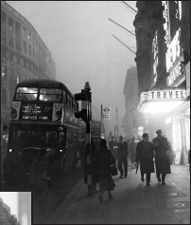

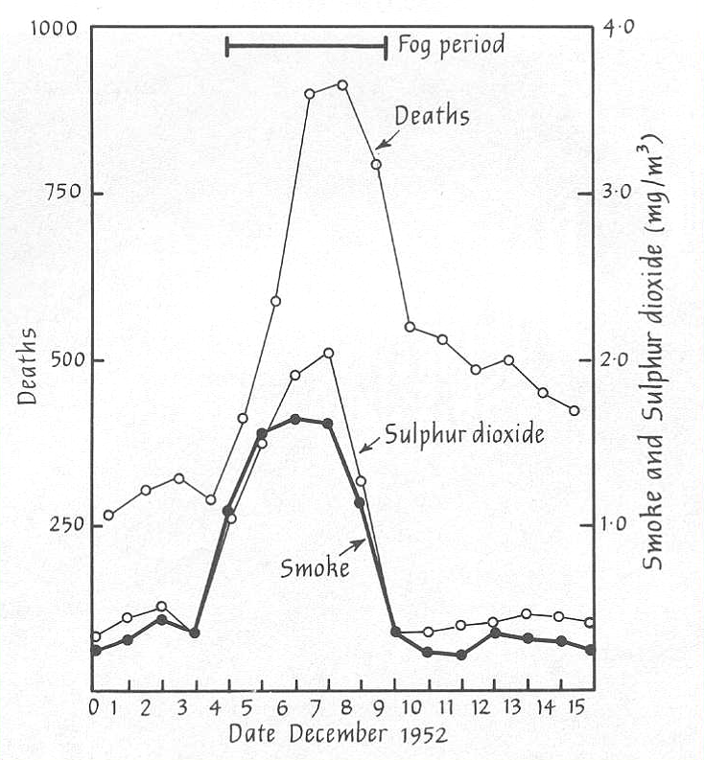
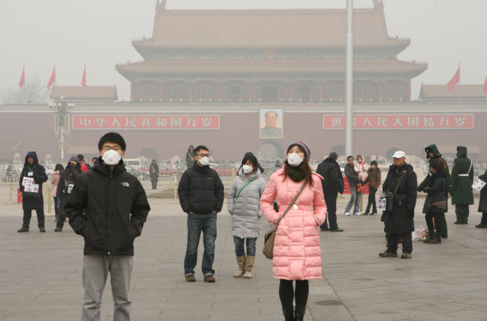
How can we start to think statistically?
Some associations are immediately apparent
Death counts and pollution levels
Paris mid-March 2014
180 μg/m³
~10,000 Excess Deaths
Beijing January 2014
755-900 μg/m³
London Dec 1952, Particulate levels – 3,000 μg/m³
Photo: National Archives
- Bell et al. 2004
Notes:
The London smog of 1952 is one of history's most important air pollution episodes in terms of its impact on science, public perception of air pollution, and government regulation. The association between health and air pollution during the episode was evident as a strong rise in air pollution levels was immediately followed by sharp increases in mortality and morbidity. However, mortality in the months after the smog was also elevated above normal levels.
"the Great Killer Smog of 1952," brought "the connection between air pollution and health to the attention of the government, public, and scientific community,"
There was an increase in mortality in all age groups but the highest increase was among the elderly. The main causes were chronic bronchitis, bronchopneumonia, and heart disease. It is quite evident that pollution causes acute respiratory and heart disease.
In this photograph, visibility is so low that the bus driver cannot see the road, even though it is mid-morning. A police officer is on foot leading the bus with a flashlight.
Even in a city legendary for its "pea-soup" fogs, the Big Smoke is the stuff of legend. In early December 1952, an area of high pressure settled over London. Residents kept piling sulfur-rich coal into their stoves to keep warm in the near-freezing temperatures. In the still air, the smoke from these stoves and from coal-fired power plants in the city formed a smog laden with sulfur dioxide and soot. On Friday, 5 December, schools closed and transportation was disrupted. On Saturday night, a performance of the opera La Traviata had to be abandoned after smog obscured the stage. It wasn't until Tuesday, 9 December, that winds finally swept away the fouled air.
By then, it was clear that a disaster was unfolding, as scores upon scores of people succumbed to respiratory or heart ailments. In 1953, the Ministry of Health concluded that the deaths of 3500 to 4000 people--nearly three times the normal toll during such a period--could be attributed to the smog. But officials decreed that any deaths after 20 December had to be from other causes. During the first 3 months of 1953, there were 8625 more deaths than expected. Officials put 5655 down to flu and listed 2970 as unexplained.

Slide 11
How can we start to think statistically?
Others….not so much
London, December, 1952
Mortality and PM₁₀ in Raleigh, NC, 2000
~10,000 Excess Deaths
NMMAPS data https://www.healtheffects.org/publication/national-morbidity-mortality-and-air-pollution-study-part-i-methods-and-methodologic
Notes:
Cardiovascular events in the greater Munich area – where the world cup was held
The FIFA World Cup 2006 in Germany started on June 9, 2006, and ended
on July 9, 2006. The 2006 World Cup matches with German participation
are indicated by numbers 1 through 7: match 1, Germany versus Costa
Rica; match 2, Germany versus Poland; match 3, Germany versus Ecuador;
match 4, Germany versus Sweden; match 5, Germany versus Argentina;
match 6, Germany versus Italy; and match 7, Germany versus Portugal (for
third-place standing). Match 8 was the final match, Italy versus France.
Italy won first place.

Slide 12
Types of data
Categorical: falls into mutually exclusive categories
Nominal: categorical without a natural order e.g., sex, ethnicity, study site
Ordinal: categorical with a natural order, e.g., socio-economic status, educational level
Discrete: countable, ordered numerical data that are whole numbers, e.g., # of students, # of strokes
Continuous: ordered numerical data that can theoretically take on any value, e.g., height, weight, age, cholesterol level
Note:
continuous data can sometimes be categorized into ordinal
discrete data can sometimes be analyzed as continuous

Slide 13
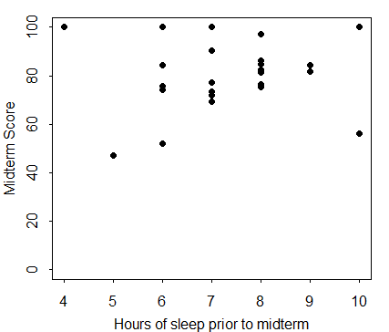
A statistical approach can help us quantify evidence for associations
Is midterm grade associated with sleep duration?
Notes:
n <- 25
par (mar=c(3,3,1,1), mgp=c(2,.7,0), tck=-.01)
set.seed(333)
x <- round(rnorm(n,7.5,1.5),0)
y <- rnorm(n,80,15)
y <- ifelse(y>100,100,y)
# No diff - cts X
plot(x,y,ylim=c(0,100),
xlab="Hours of sleep prior to midterm", ylab="Midterm Score",
pch=16)
# No diff - dichotomized X
plot(x,y,ylim=c(0,100),
xlab="Hours of sleep prior to midterm", ylab="Midterm Score",
pch=16,col=ifelse(x>=8,4,2))
# No diff - dichotomized X , y-10 for high sleep
plot(x,ifelse(x>=8,y-10,y),ylim=c(0,100),
xlab="Hours of sleep prior to midterm", ylab="Midterm Score",
pch=16,col=ifelse(x>=8,4,2))
# No diff - dichotomized X , y-25 for high sleep
plot(x,ifelse(x>=8,y-25,y),ylim=c(0,100),
xlab="Hours of sleep prior to midterm", ylab="Midterm Score",
pch=16,col=ifelse(x>=8,4,2))

Slide 14
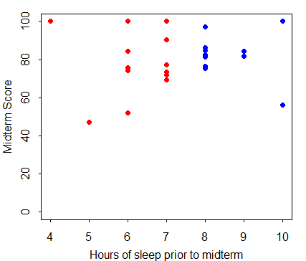
A statistical approach can help us quantify evidence for associations
Is there a difference in midterm grades comparing short (<8 hours) vs. long (≥8 hours) sleepers?

Slide 15
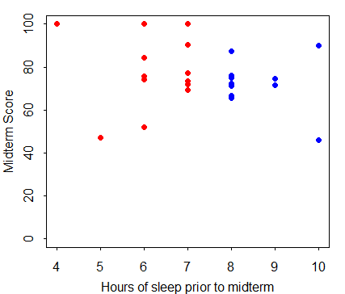
A statistical approach can help us quantify evidence for associations
Is there a difference in midterm grades comparing short (<8 hours) vs. long (≥8 hours) sleepers? Now?

Slide 16
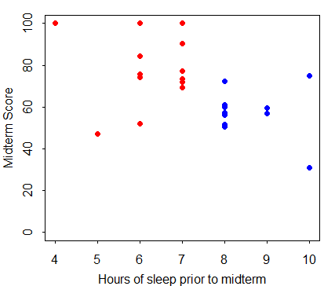
A statistical approach can help us quantify evidence for associations
Is there a difference in midterm grades comparing short (<8 hours) vs. long (≥8 hours) sleepers? And now?

Slide 17
Population vs. Inference about population from a sample
Objective: understand a population using information obtained from a sample
This approach is subject to sampling variability and/or bias
Population
Sample

Slide 18
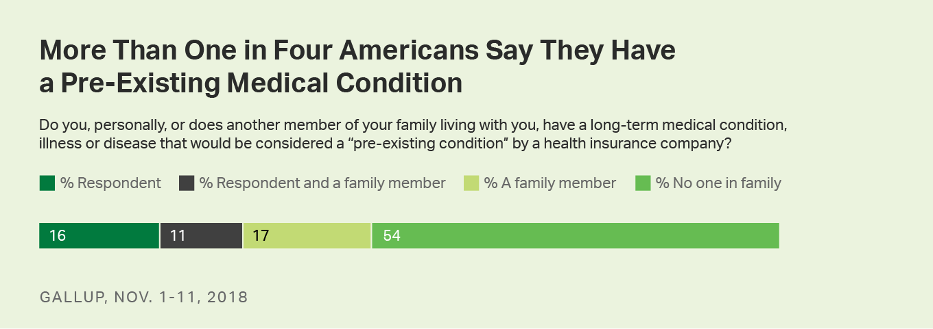
Example: sampling to make inferences about a population
Nov 2018 Gallup poll estimates that 27.0% of Americans have a long-term medical condition, illness or disease that a health insurance company would consider a pre-exisiting condition.
How do they know this? Did they ask you?
https://news.gallup.com/poll/245108/one-four-adults-say-pre-existing-condition.aspx

Slide 19
Gallup poll methodology
If you read the fine print:
“Results for this Gallup poll are based on telephone interviews conducted Nov 1-11, 2018, with a random sample of 1,024 adults, aged 18 and older, living in all 50 U.S. states and the District of Columbia. For results based on the total sample of national adults, the margin of sampling error is ±4 percentage points at the 95% confidence level. All reported margins of sampling error include computed design effects for weighting.”
Population of the United States: ~326,000,000
Is sampling 1000 adults enough?
Note on sampling:
“Each sample of national adults includes a minimum quota of 70% cellphone respondents and 30% landline respondents, with additional minimum quotas by time zone within region. Landline and cellular telephone numbers are selected using random-digit-dial methods.”

Slide 20
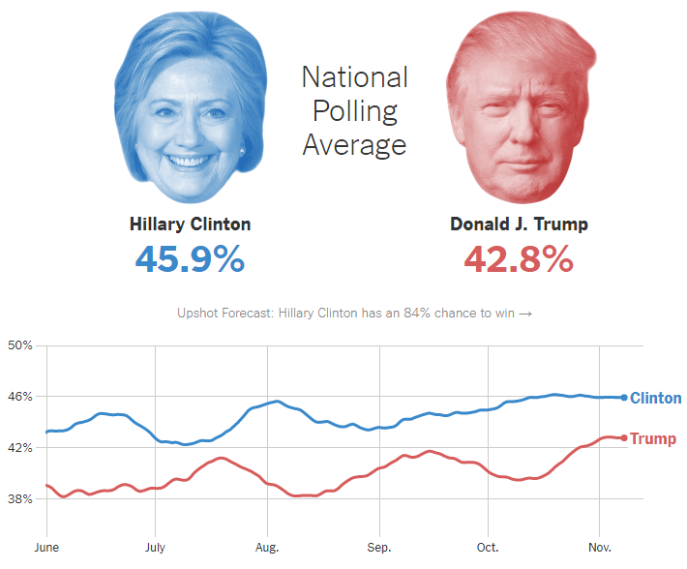
Sampling fail: 2016 presidential election polls
Polls predicted Clinton win
→ WRONG! Why?
Likely polling problems:
Nonresponse bias: certain groups of people didn’t respond
Turnout: Sample not representative of election day voters
Late momentum for Trump (many polls stopped mid-Oct)
Dishonesty in response to poll questions
National polls OK, but state polls (esp. key states) were off
https://www.nytimes.com/interactive/2016/us/elections/polls.html
A USC poll did get it right: https://www.latimes.com/politics/la-na-pol-convention-bounce-20160725-snap-htmlstory.html
Notes:
https://en.wikipedia.org/wiki/Nationwide_opinion_polling_for_the_2016_United_States_presidential_election#cite_note-274
Education was a key factor, not fully accounted for in some polling methods (e.g. weights)
Electoral college: Michigan, Wisconsin, Pennsylvania
Popular vote: Clinton=48.5, Trump=46.4
Russia?

Slide 21
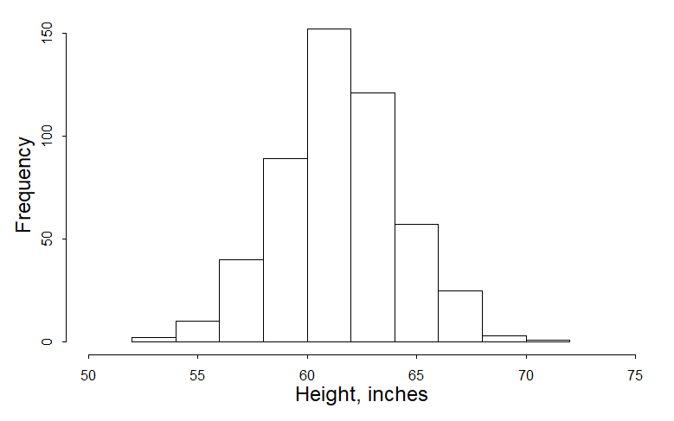
Our first “statistics”
Describing a distribution (e.g., height):
Measures of central tendency
Measures of spread
Notes:
5’4” (my height): 64 in = 162.6 cm
set.seed(123)
n <- 500
ht <- rnorm(n,mean=61.4,sd=2.8) # inches
par (mar=c(4,4,1,1), mgp=c(2,.7,0), tck=-.01)
hist(ht,xlab="Height, inches",main="",cex.lab=1.5,xlim=c(50,75))
abline(v=mean(ht),col=2)
abline(v=median(ht),col=2)
abline(v=quantile(ht,c(.25,.75)),col=4)
mean(ht)
median(ht)
quantile(ht,c(.25,.5,.75))
min(ht)
max(ht)
range(ht)
IQR(ht)
sd(ht)
var(ht)

Slide 22
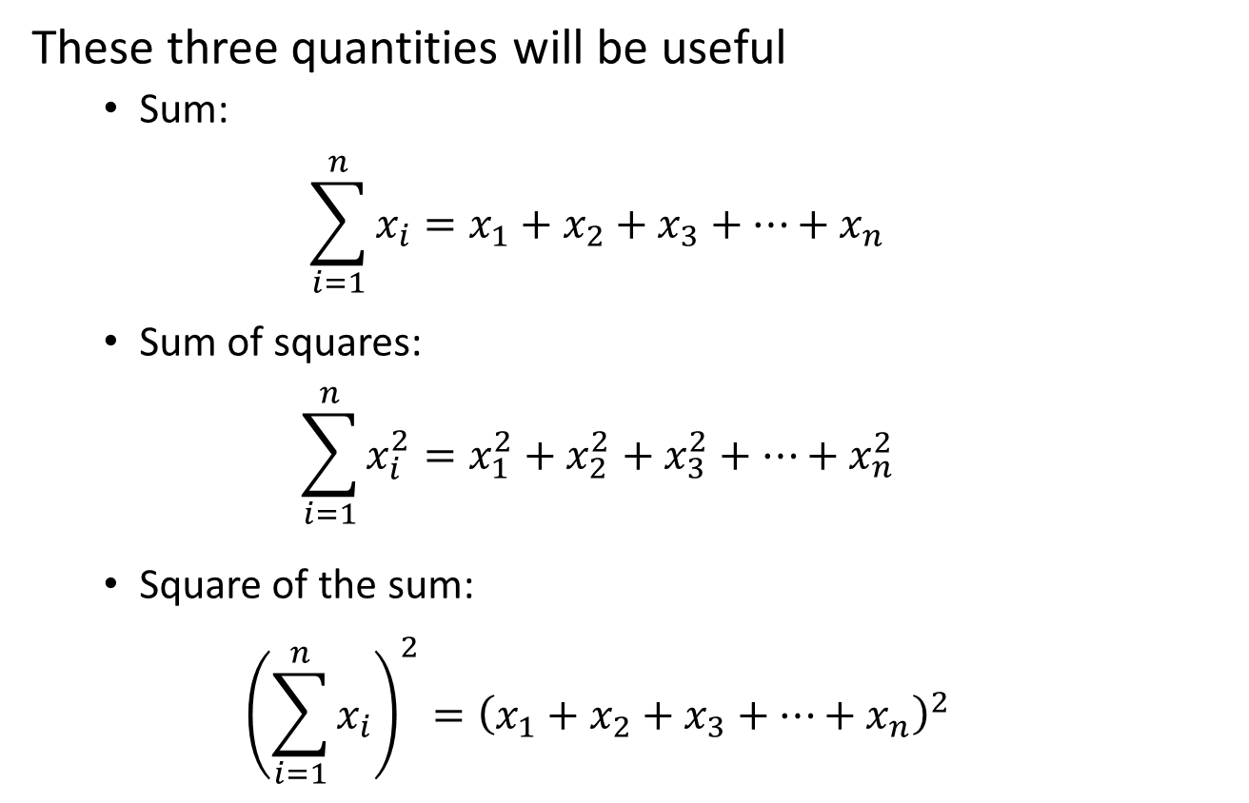
Some Notation
These three quantities will be useful
Sum:
$$\sum_{i=1}^{n}{x_{i}=x_{1}+x_{2}+x_{3}+…+x_{n}}$$
Sum of squares:
$$\sum_{i=1}^{n}{x_{i}^{2}=x_{1}^{2}+x_{2}^{2}+x_{3}^{2}+…+x_{n}^{2}}$$
Square of the sum:
$${\left(\sum_{i=1}^{n}{x_{i}}\right)}^{2}={\left(x_{1}+x_{2}+x_{3}+…+x_{n}\right)}^{2}$$

Slide 23
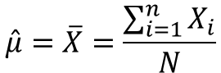
Percentiles and Central tendency
Percentiles (e.g., 75% of the data is to the left of the 75th percentile)
Measures of “central tendency”; “middle” of the data
Median: the 50th percentile
Mean (average):
Mode: value occurring most often (discrete/categorical data)
For continuous data, the value at the “peak”
$$\hat{μ}=\overline{X}=\frac{\sum_{i=1}^{n}{X_{i}}}{N}$$

Slide 24
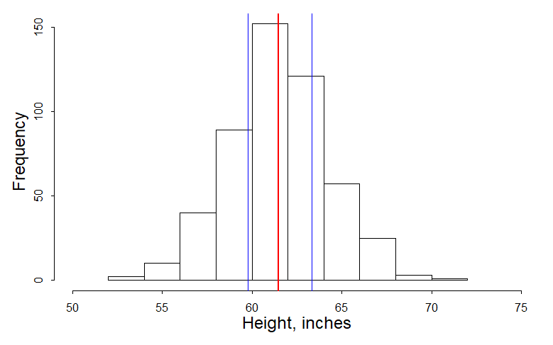
Height: central tendency & percentiles
25th percentile 59.8 in
75th percentile 63.3 in
Mean ≈ Median ≈ Mode 61.5 in

Slide 25
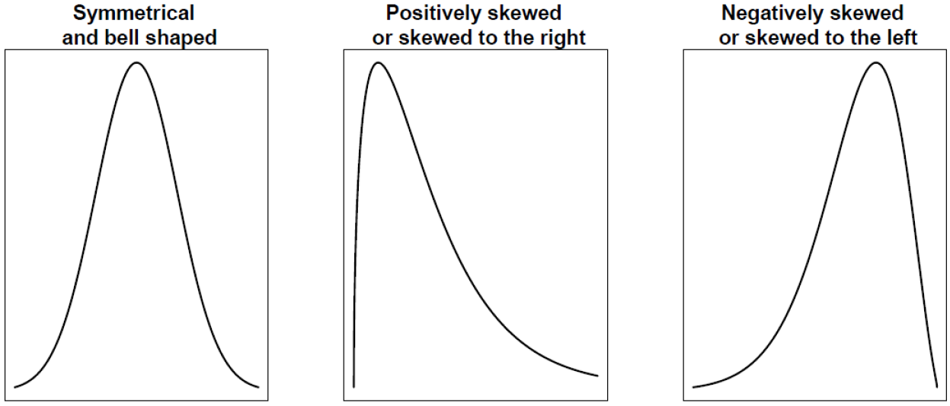
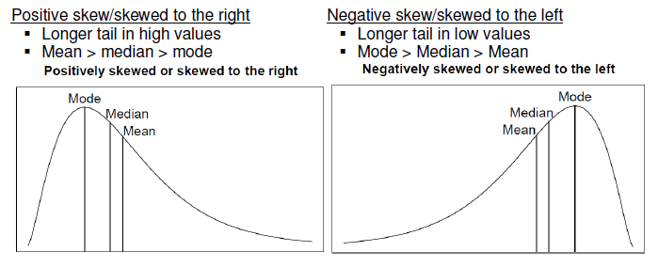
Note: common distribution shapes
Mean = Median = Mode

Slide 26
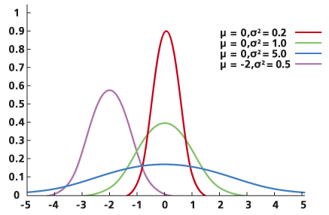
Central tendency vs. spread
Measures of central tendency alone do not adequately describe the distribution of the data
Also need to describe the “spread” in the data

Slide 27
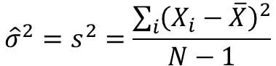
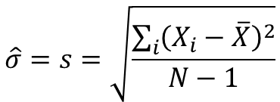
Measures of spread
Range: difference between largest and smallest value
Interquartile range (IQR): difference between 75th and 25th percentile values
Variance: “average” squared deviation from the mean
units: inches²
Standard deviation (SD): square root of variance
unit: inches
$${\hat{σ}}^{2}=s^{2}=\frac{\sum_{i}{{\left(X_{i}−\overline{X}\right)}^{2}}}{N−1}$$
$$\hat{σ}=s=\sqrt{\frac{\sum_{i}{{\left(X_{i}−\overline{X}\right)}^{2}}}{N−1}}$$
Notes:
Note: this is the POPULATION variance, not the sample variance!!

Slide 28
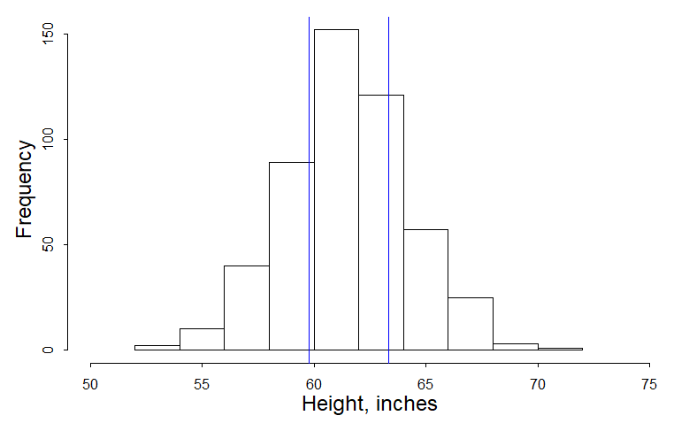
Height: measures of spread
Min: 53.9 in
Max: 70.5 in
25th percentile 59.8 in
75th percentile 63.3 in
IQR = 3.5 in
Variance: 7.4 in²
Standard deviation: 2.7 in
Range: 16.6 in

Slide 29
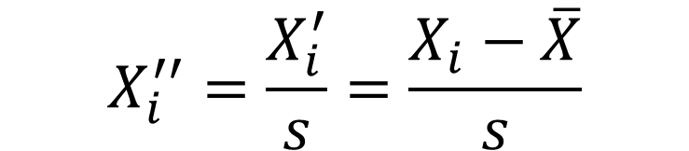
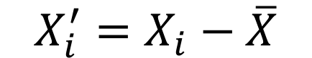
Standardization: scaling and centering
You might want to compare values coming from distributions in different populations
Standardization can help:
“Center” by subtracting the mean
New mean = 0
“Scaled” by dividing by the standard deviation
New standard deviation = 1
Now a 1 unit change in X” is equivalent to a SD change in X
$$X_{i}^{′}=X_{i}−\overline{X}$$
$$X_{i}^{′′}=\frac{X_{i}^{′}}{s}=\frac{X_{i}−\overline{X}}{s}$$

Slide 30
3 distributions - original

Slide 31
3 distributions - centered

Slide 32
3 distributions – centered and scaled

Slide 33
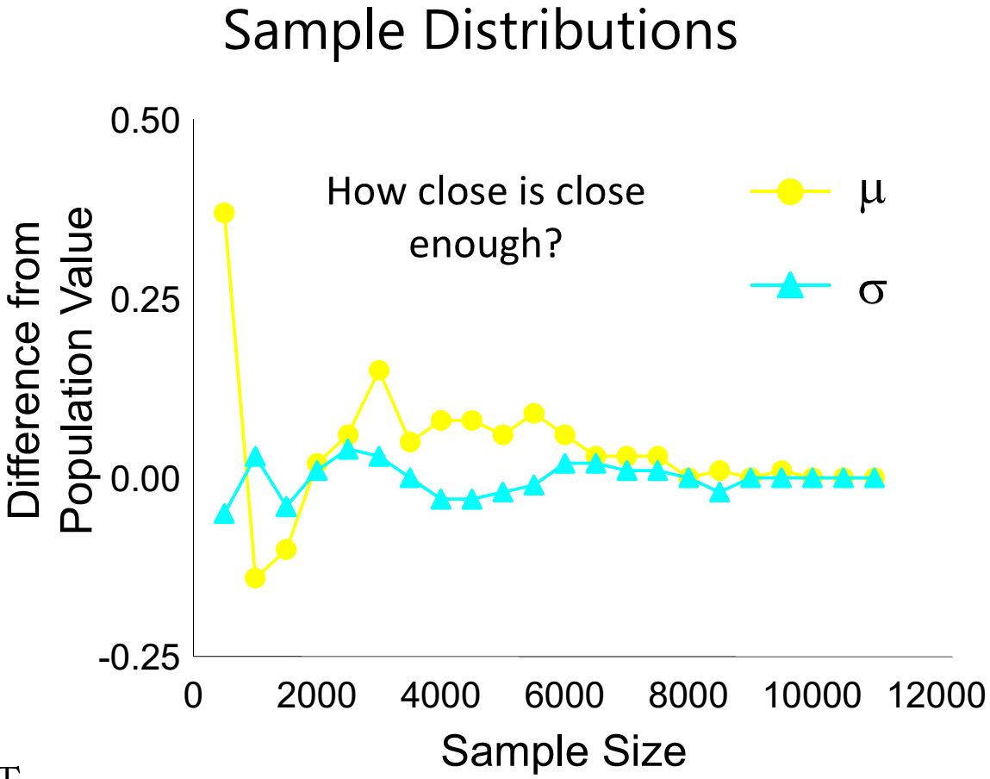
Sample vs. population distribution
Typically never get to observe population distribution
Estimate population parameters by sampling from the population
Ability to accurately characterize population depends on representativeness of sample and sample size
In practice, not all data are normal
Statistical methods fall into two broad categories
Parametric: assumes data follow a given distribution
Non-parametric (distribution-free): does not assume a distribution
Some statistics are more robust than others to deviation from the assumed distribution

Slide 34
Examples: sample distributions
Fasting cholesterol levels in 1,752 Mexican Americans

Slide 35
Examples: sample distributions
Fasting insulin levels in 1,752 Mexican Americans

Slide 36
Examples: sample distributions
Percentage body fat in 1,752 Mexican Americans

Slide 37
Examples: sample distributions
Percentage body fat in 1,752 Mexican Americans

Slide 38
Recap of today: introduction to biostatistics
Biostatistics/biostatistical thinking
Signal vs noise
Types of data
Population vs. sample
Measures of central tendency
Measures of spread
Scaling
+ BONUS MATERIAL

Slide 39
The seven deadly sins of statistical data analysis
By Sandy Eckel
Similar ideas elsewhere:
Kuzon WM Jr, Urbanchek MG, McCabe S. (1996) The seven deadly sins of statistical analysis. Ann Plast Surg. Sep;37(3):265-72.
Scott R. Millis (2003): Statistical Practices: The Seven Deadly Sins, Child Neuropsychology, 9:3, 221-233
http://www.columbia.edu/cu/21stC/issue-3.3/ross.html

Slide 40

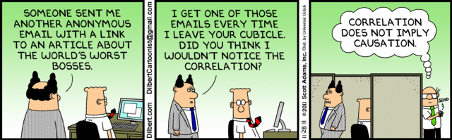
1. Correlation ≠ causation
http://xkcd.com/552/

Slide 41
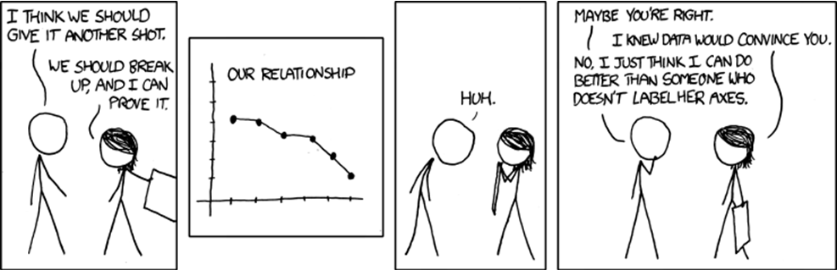
2. Displaying data badly
http://xkcd.com/833/
H Wainer (1984) How to display data badly. American Statistician 38(2):137-147
http://ocw.jhsph.edu/courses/BiostatisticsLectureSeries05/PDFs/Broman.pdf

Slide 42
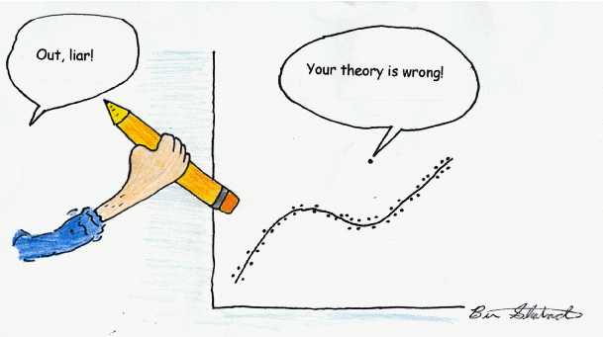
3. Failing to assess model assumptions
http://davidmlane.com/ben/cartoons.html

Slide 43
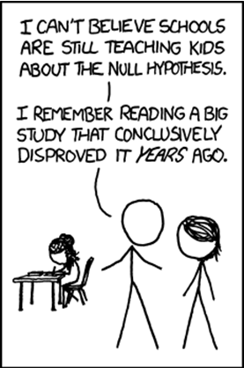
4. Over-reliance on hypothesis testing
NEVER accept the null hypothesis; instead fail to reject H₀
http://xkcd.com/892/

Slide 44
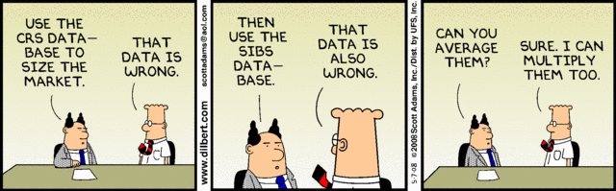
5. Drawing inference from biased samples

Slide 45
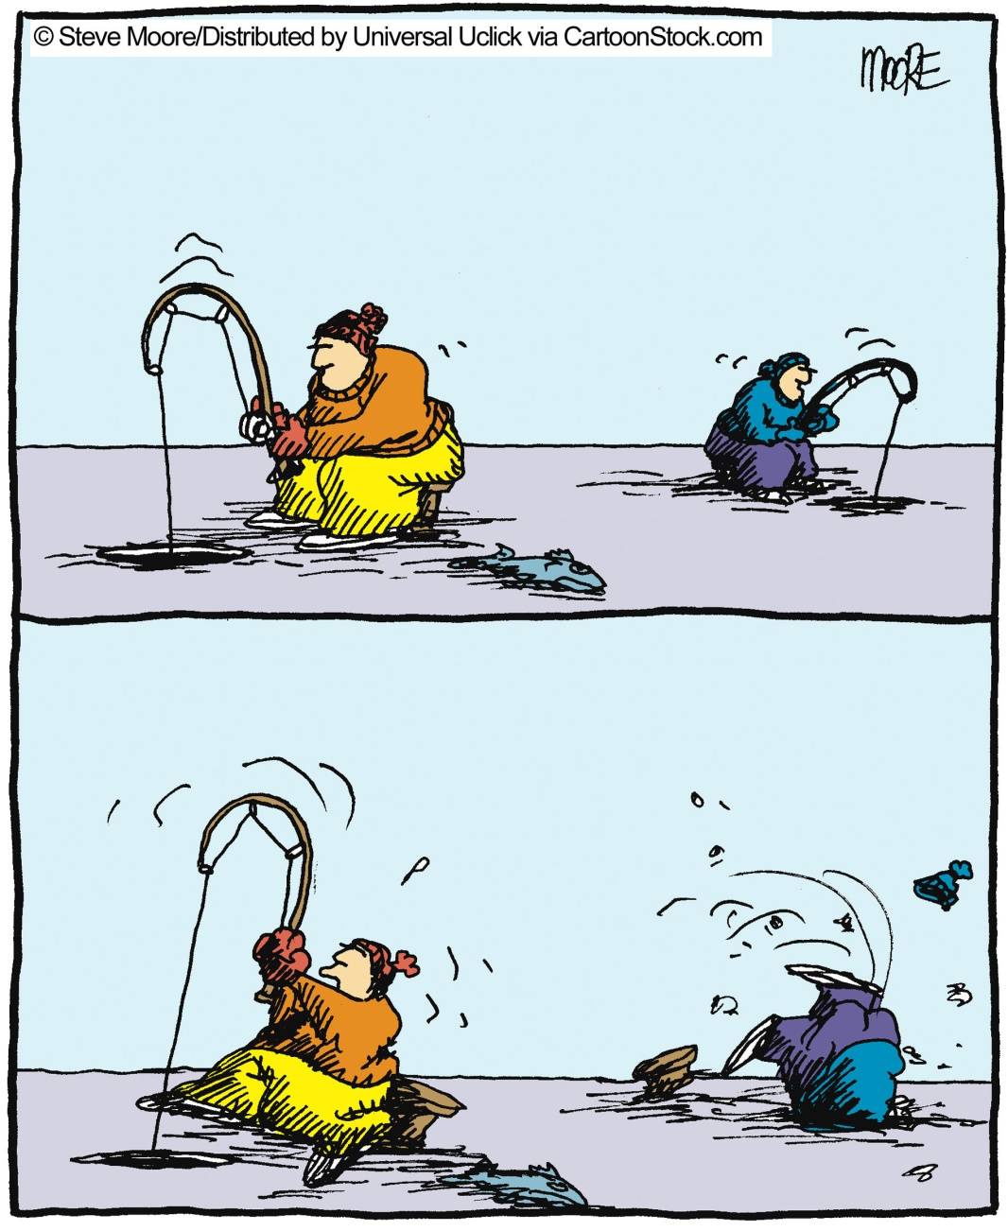
6. Data dredging

Slide 46

7. Extrapolating beyond range of data
http://xkcd.com/605/

Slide 47
Thank you!

